Slide 1
Phoenix ABPM
System Architecture
Christopher J Adams
Phoenix Project
http://www.phoenix.tc-ieee.org/
adamscj@ieee.org
© 2009 Christopher J. Adams
This work is licensed under the Creative Commons Attribution 3.0 Unported License.
To view a copy of this license, visit http://creativecommons.org/licenses/by/3.0/ or send a letter to Creative Commons, 171 Second Street, Suite 300, San Francisco, California, 94105, USA.

Slide 2
Table of Contents
Enterprise Viewpoint
  Vision + Mission (Why)
  Architectural Requirements
Engineering Viewpoint
Shared Inquiry
Not today:
Context & scope
Usage scenarios
Computational viewpoint
Information viewpoint
Technology viewpoint

Slide 3
Phoenix Vision
Measurement
  Blood pressure
  Heart rate
Repetitive
Around-the-clock
Week or longer
Analysis tools
  Self care
  Diagnosis
  Prevention
  & Pre-habilitation
  Treatment
  & Re-habilitation
Long term
Massive scale
Notes:
Repetitive -- automatic, periodic measurement
Around-the-clock -- regardless of person’s activity
Week or longer -- initially, collect at least one week of data per session
Long term -- data for an individual may span the individual’s life
Massive scale
From current load of hundreds of sessions per year
To millions of sessions per year

Slide 4
Project Mission
Develop ambulatory blood pressure monitor
  Inexpensive
  Unobtrusive
  Easy to use
  Collects a week of blood pressure measurements
Develop software
  Chronobiological analysis of collected blood pressure measurements
Notes:
Inexpensive
Price not a barrier to use
Less expensive than blood pressure cuff
Less expensive than wrist watch (< US$50)
Less expensive than “two bushels of yams” (globally affordable, < US$10)
Unobstrusive
When wearing monitor, patient can
Forget about, be unaware of device
No more encumbering than wrist watch, Band-aid™, piece of jewelry
Usable wherever the patient is
At home, at work
Not only in clinical setting
Easy to use
Easier to use than current BP cuffs, home BP monitors
Patient can:
Ignore device
Determine that device is functioning normally
Observe a blood pressure and heart rate measurement
Device is automatic -- takes measurements regardless of patient behavior
Allows manually initiated measurements

Slide 5
Architectural Requirements
Inexpensive
  Open source
  Free intellectual property, volunteer labor
Highly decomposed
  Consequence of open source
  Each component quickly engineered
  by very small team (usually one person)
Extensible -- highly recomposable
  Consequence of multiple actors, vaguely organized
  Evolving user classes, usage scenarios, environments
  Highly re-usable components

Slide 6
Architectural Requirements
Scalable
  Ready to cope with volume increases
    Wearers
    Acquired data
    Analysis requests
Security & Privacy
  Principles:
    Wearer owns measurements of the wearer’s body
    Caregivers are custodians
    Control belongs to the wearer
  Manage person (patient) identity externally
Notes:
NOTE: Project has not yet investigated security issues

Slide 7
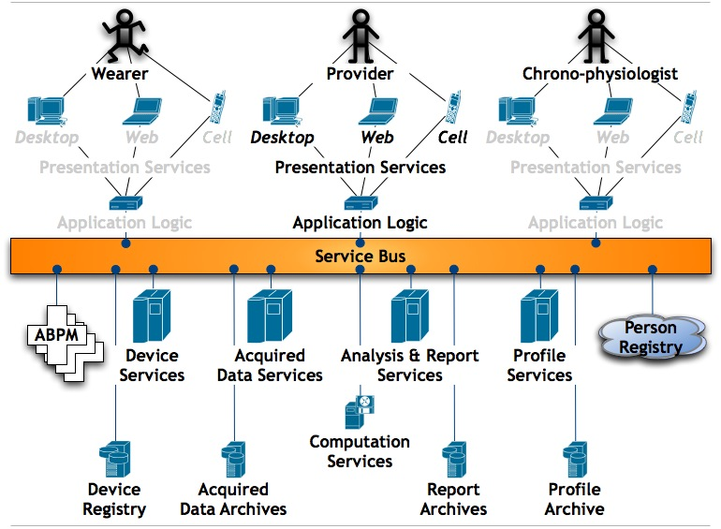
Engineering Viewpoint
Notes:
Here is a preview of the architecture.
The following slides will assemble the architecture in comprehensible chunks.

Slide 8
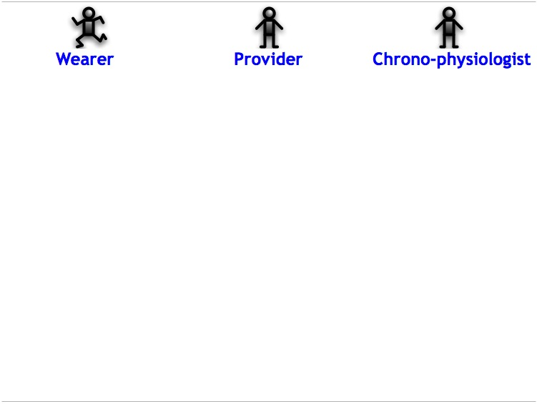
Actors
Notes:
Actors -- Users of the device or software
Wearer
The person whose vital signs are measured by the device
Varies with setting
Patient
Self-care subject
Athlete
Student
Provider
The person who fits the wearer with the device & provides analytic services
Clinician
Pharmacist
Coach
Teacher
ISSUE: Do not yet know if a person may play both Wearer and Provider roles
Chrono-physiologist
The person who models whole populations of wearers
Develops profiles for parametric analysis techniques
Develops new analysis techniques

Slide 9
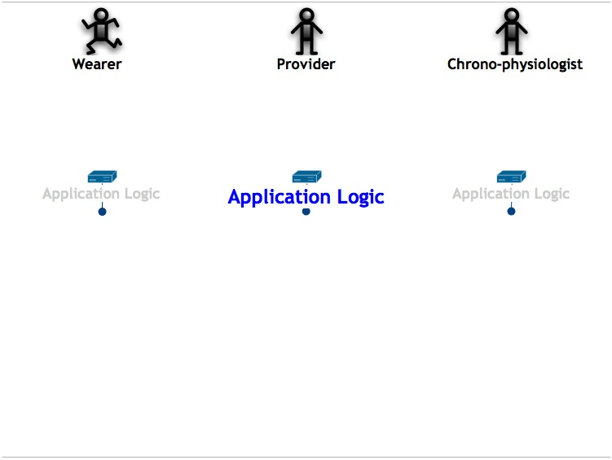
Applications
Notes:
Each user class has its own workflow(s)
Applications are at least actor-specific, if not workflow-specific
Expect the user classes to evolve --> new applications over time

Slide 10
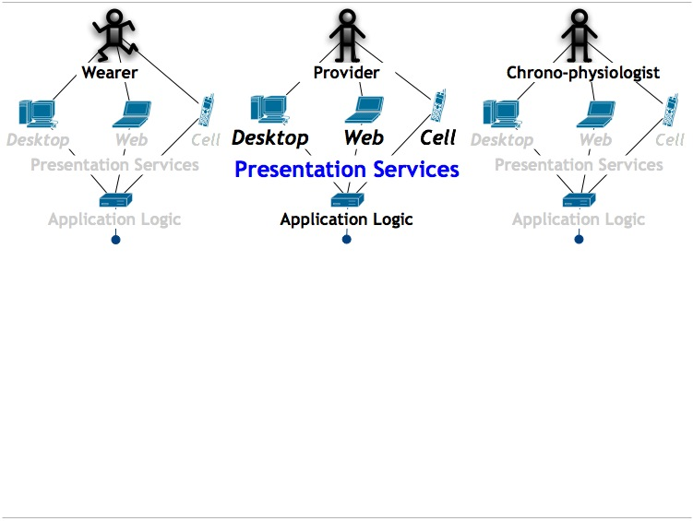
Presentation Services
Notes:
Presentation & user interface technology will vary with setting, user class, and individual preference
Desktop applications -- the current norm
Internet application
Mobile / cell phone application
Not all channels make sense for all features

Slide 11
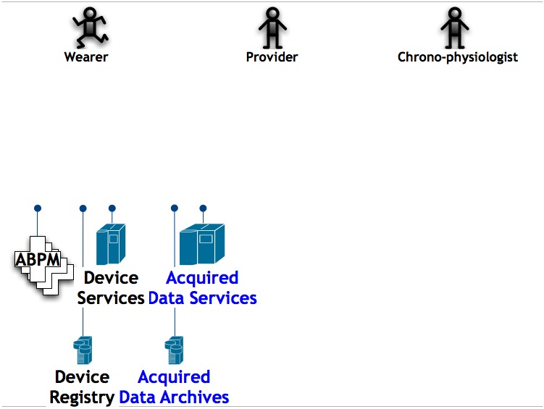
Data Acquisition
Notes:
Device measures the wearer
Each measurement accompanied by
Time-stamp
Device ID
Measurements are uploaded and archived via data acquisition services
Each device
Has status
Has maintenance records
Has make, model and version
May have assignment to a wearer
Services include:
Adapting a specific make, model, version to Phoenix canonical model
Linking sessions into coherent time series?

Slide 12
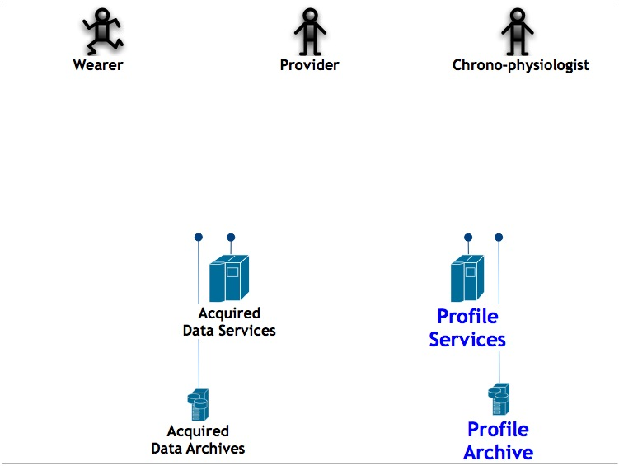
Modeling and Profiling
Notes:
Chrono-physiologist models blood pressure profiles needed for analysis techniques

Slide 13
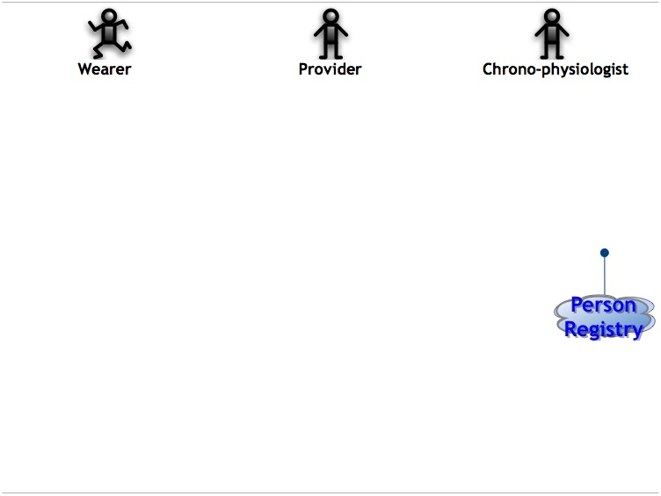
Person Identity Management
Notes:
For Privacy -->manage person (patient) identity externally
There may be multiple registries
Responsible for authentication
When link between person and data is needed
Person registers
Person logs into registry to obtain key token
Links based on key token
System never attempts to decode token
ISSUE: Project has not yet investigated security ramifications

Slide 14
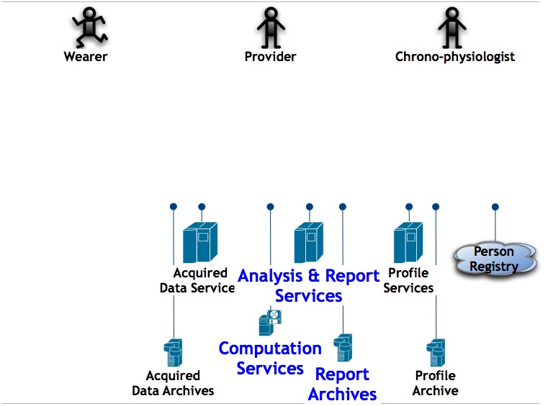
Analysis & Reporting
Notes:
Provider assesses the data collected by the system
The analysis techniques encoded within a computational services
Procedures are defined as a collection of
Generation of reports (e.g., sphygmochron)

Slide 15
Engineering Viewpoint
Notes:
The whole system is hung together off a “Service Bus”
Responsible for routing each service request to correct service provider
Should support multiple versions of the server configuration
End result
Layered
Service oriented
Can be distributed

Slide 16
Shared Inquiry
What is missing?
What is feasible in your setting?
Who owns the servers?
Who are the custodians of data?
Who owns what data?

Slide 17
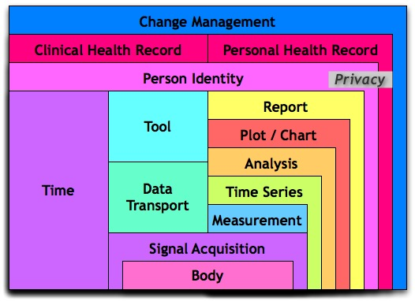
Appendix
Computational Viewpoint

